Slide 1
Digital
Digital = discrete
  Binary codes (example: BCD)
  Decimal digits 0-9
Binary codes
  Represent symbols using binary digits (bits)
Digital computers:
  I/O is digital
    ASCII, decimal, etc.
  Internal representation is binary
    Process information in bits
Decimal
Symbols
0
1
2
3
4
5
6
7
8
9
BCD
Code
0000
0001
0010
0011
0100
0101
0110
0111
1000
1001

Slide 2
The basics: Binary numbers
Bases we will use
  Binary: Base 2
  Octal: Base 8
  Decimal: Base 10
  Hexadecimal: Base 16
Positional number system
  101₂= 1×2² + 0×2¹ + 1×2⁰
  63₈ = 6×8¹ + 3×8⁰
  A1₁₆= 10×16¹ + 1×16⁰
Addition and subtraction
1011
+ 1010
10101
1011
– 0110
0101

Slide 3
Binary → hex/decimal/octal conversion
Conversion from binary to octal/hex
  Binary: 10011110001
  Octal: 10 | 011 | 110 | 001=2361₈
  Hex: 100 | 1111 | 0001=4F1₁₆
Conversion from binary to decimal
  101₂= 1×2² + 0×2¹ + 1×2⁰ = 5₁₀
  63.4₈ = 6×8¹ + 3×8⁰ + 4×8^{–1} = 51.5₁₀
  A1₁₆= 10×16¹ + 1×16⁰ = 161₁₀

Slide 4
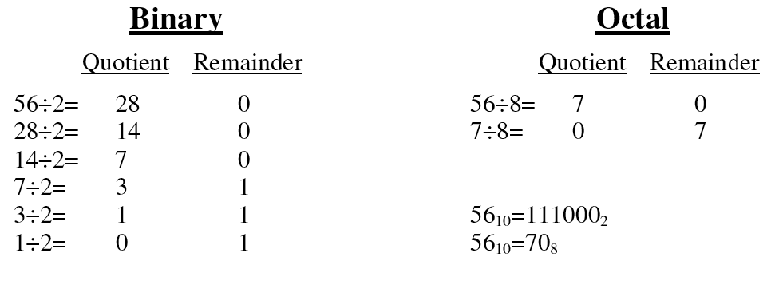
Decimal→ binary/octal/hex conversion

Slide 5
Number systems
How do we write negative binary numbers?
Historically: 3 approaches
  Sign-and-magnitude
  Ones-complement
  Twos-complement
For all 3, the most-significant bit (MSB) is the sign digit
  0 ≡ positive
  1 ≡ negative
twos-complement is the important one
  Simplifies arithmetic
  Used almost universally

Slide 6
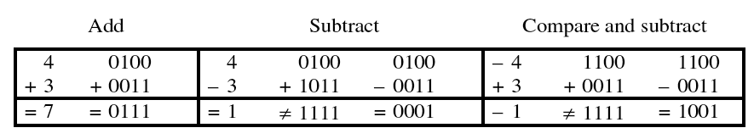
Sign-and-magnitude
The most-significant bit (MSB) is the sign digit
  0 ≡ positive
  1 ≡ negative
The remaining bits are the number’s magnitude
Problem 1: Two representations for zero
  0 = 0000 and also –0 = 1000
Problem 2: Arithmetic is cumbersome

Slide 7
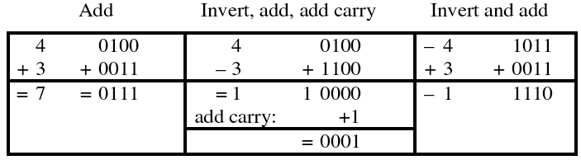
Ones-complement
Negative number: Bitwise complement positive number
  0011 ≡ 3₁₀
  1100 ≡ –3₁₀
Solves the arithmetic problem
Remaining problem: Two representations for zero
  0 = 0000 and also –0 = 1111

Slide 8
Twos-complement
Negative number: Bitwise complement plus one
  0011 ≡ 3₁₀
  1101 ≡ –3₁₀
Number wheel
– 1
0
– 2
1111
0000
+ 1
– 3
1110
0001
+ 2
◆ Only one zero!
◆ MSB is the sign digit
■ 0 ≡ positive
■ 1 ≡ negative
1101
0010
– 4
1100
0011
+ 3
– 5
1011
0100
+ 4
1010
0101
– 6
1001
0110
+ 5
– 7
1000
0111
+ 6
– 8
+ 7

Slide 9
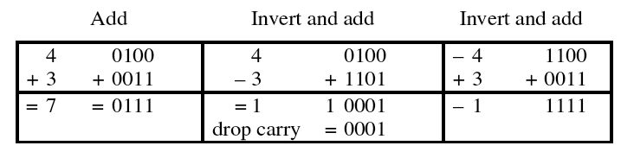
Twos-complement (con’t)
Complementing a complement  the original number
Arithmetic is easy
  Subtraction = negation and addition
    Easy to implement in hardware

Slide 10
Miscellaneous
Twos-complement of non-integers
  1.6875₁₀ = 01.1011₂
  –1.6875₁₀ = 10.0101₂
Sign extension
  Write +6 and –6 as twos complement
    0110 and 1010
  Sign extend to 8-bit bytes
    00000110 and 11111010
Can’t infer a representation from a number
  11001 is 25 (unsigned)
  11001 is –9 (sign magnitude)
  11001 is –6 (ones complement)
  11001 is –7 (twos complement)

Slide 11
Twos-complement overflow
Summing two positive numbers gives a negative result
Summing two negative numbers gives a positive result
Make sure to have enough bits to handle overflow
– 1
0
– 1
0
– 2
1111
0000
+ 1
– 2
1111
0000
+ 1
– 3
1110
0001
+ 2
– 3
1110
0001
+ 2
1101
0010
1101
0010
– 4
1100
0011
+ 3
– 4
1100
0011
+ 3
– 5
1011
0100
+ 4
– 5
1011
0100
+ 4
1010
0101
1010
0101
– 6
1001
0110
+ 5
– 6
1001
0110
+ 5
– 7
1000
0111
+ 6
– 7
1000
0111
+ 6
– 8
+ 7
– 8
+ 7
6 + 4 ⇒ –6
–7 – 3 ⇒ +6

Slide 12
Gray and BCD codes
Decimal
Symbols
0
1
2
3
4
5
6
7
8
9
Gray
Code
0000
0001
0011
0010
0110
0111
0101
0100
1100
1101
Decimal
Symbols
0
1
2
3
4
5
6
7
8
9
BCD
Code
0000
0001
0010
0011
0100
0101
0110
0111
1000
1001

